Slide 1
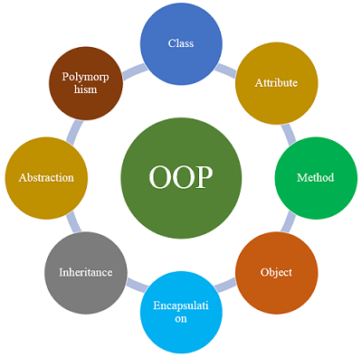
Lecture - 2 Basic Concepts and Features of OOP
Afsara Tasneem Misha
Lecturer
Department of CSE
Daffodil International University

Slide 2
Today’s Contents
Basic concepts of OOP
Basic Features of OOP

Slide 3
Today’s Contents
Basic concepts of OOP
Object
Class
Methods
Instance Variables
Basic Features of OOP
Abstraction
Encapsulation
Polymorphism
Inheritance

Slide 4
Concepts of OOP
Object
Class
Instance Variables
Methods

Slide 5
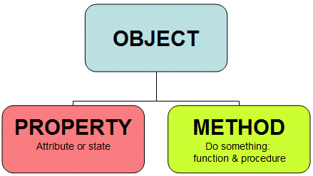
1. Object
Real world entity.
Bundle of related variables and functions (also known methods).
Objects share two characteristics:
1. Properties / State
2. Method / Behavior (Functionalities)

Slide 6
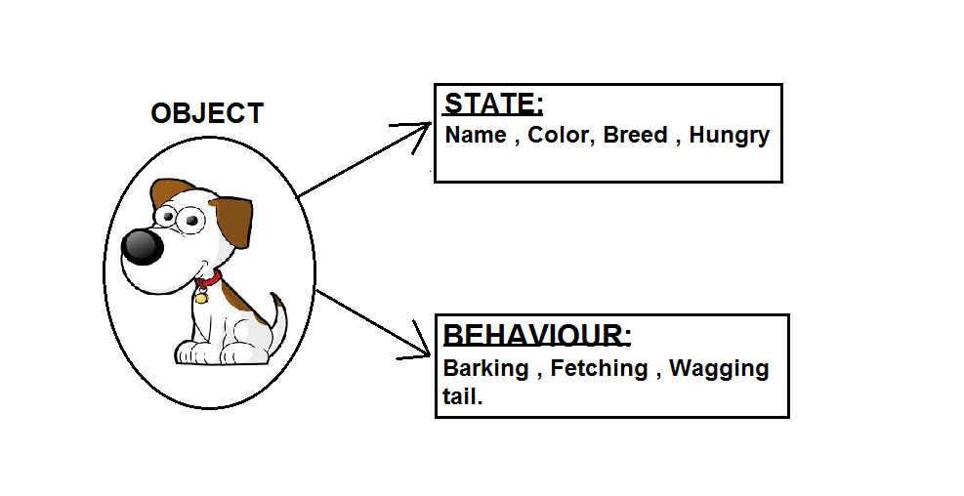
An Object

Slide 7
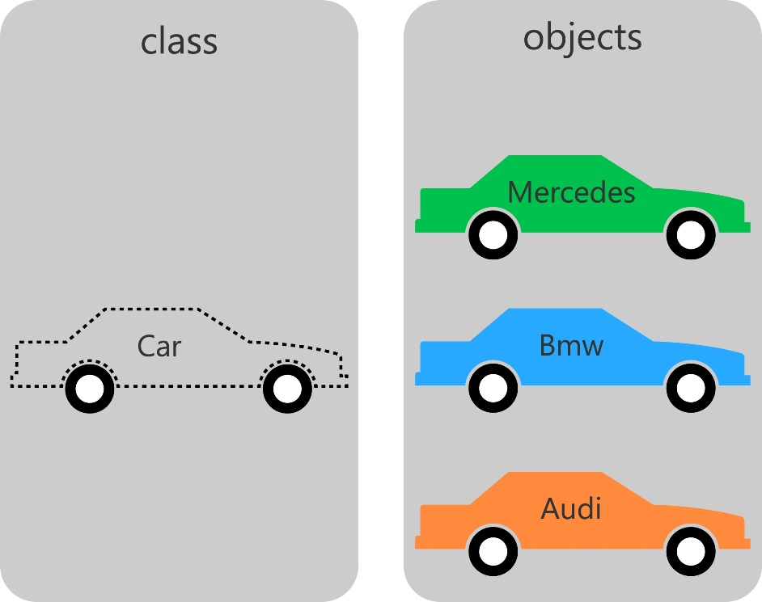
2. Class
A class can be defined as a template/blueprint of an object that describes the behaviors/states that object.

Slide 8
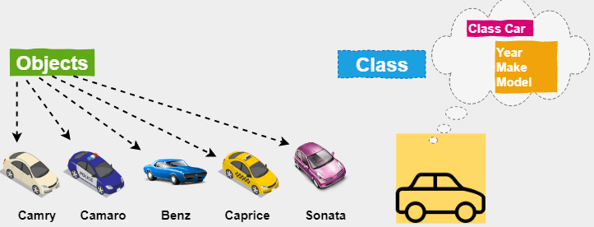
Class: A template/blueprint of an objects

Slide 9
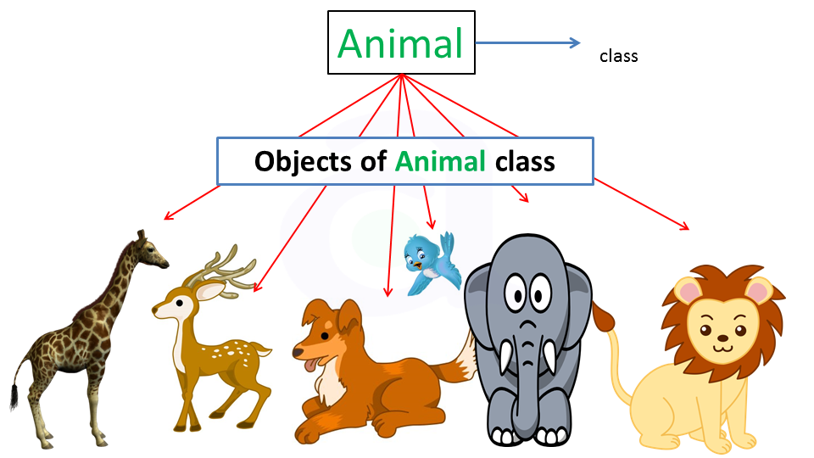
Class: A template/blueprint of an objects

Slide 10
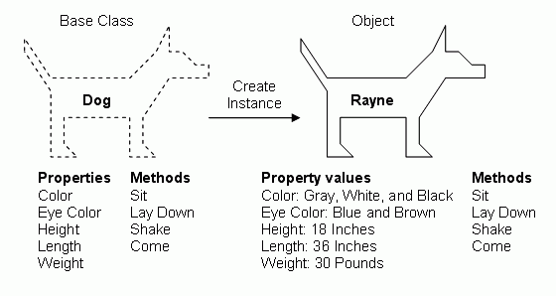

Slide 11
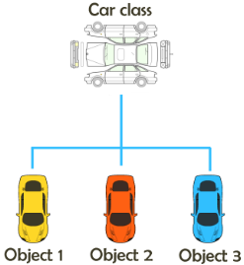
The Class represents a template to for creating objects of that class

Slide 12
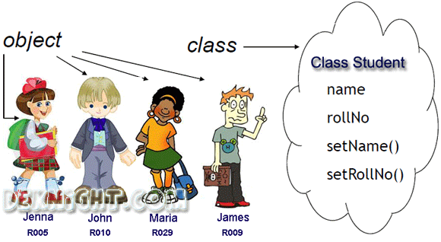

Slide 13
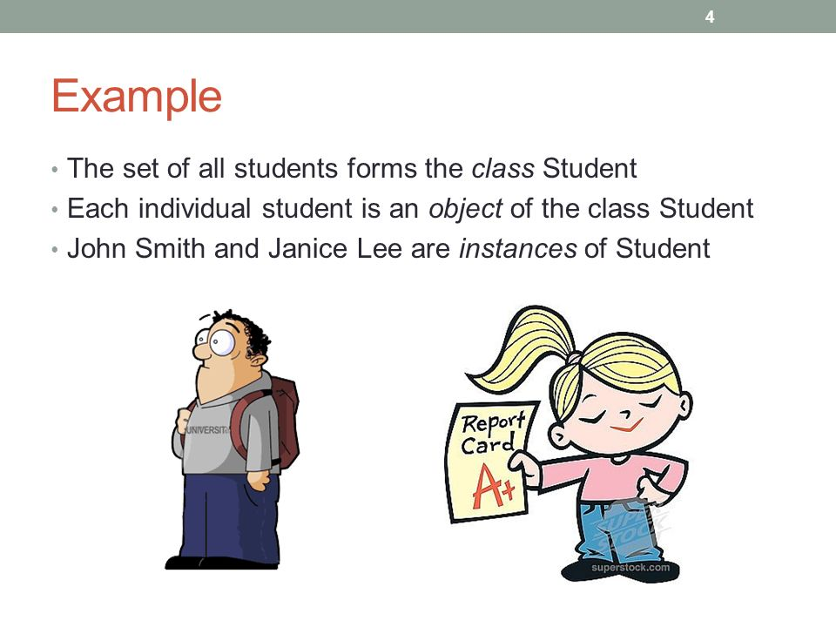

Slide 14
3. Methods
A method is basically a behavior.
A class can contain many methods.
It is in methods where the logics are written, data is manipulated and all the actions are executed.

Slide 15
4 Instance Variables
Each object has its unique set of instance variables.
Such as,
A Box can have Height, Width, Depth.
These are the Instance variables of that box.
An object's state is created by the values assigned to these instance variables.

Slide 16
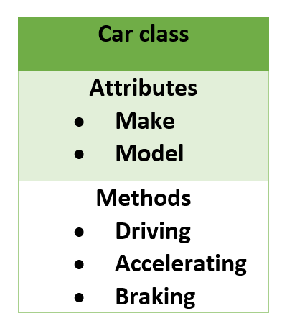
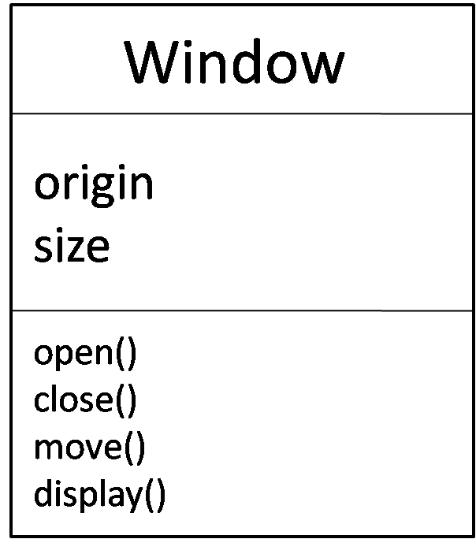
UML: Unified Modeling Language UML Representation of CLASS
ClassName
Instance Variables
Methods

Slide 17
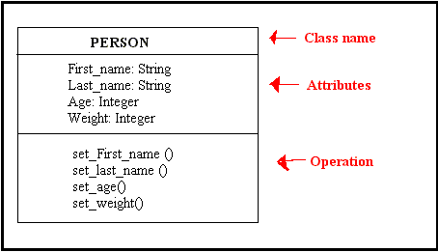

Slide 18
Features Of OOP

Slide 19
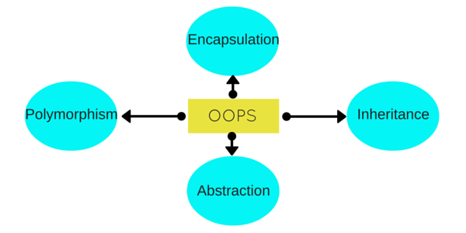
Features of OOP

Slide 20
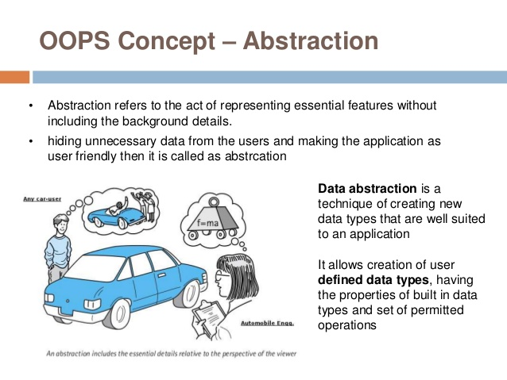
1. Abstraction

Slide 21
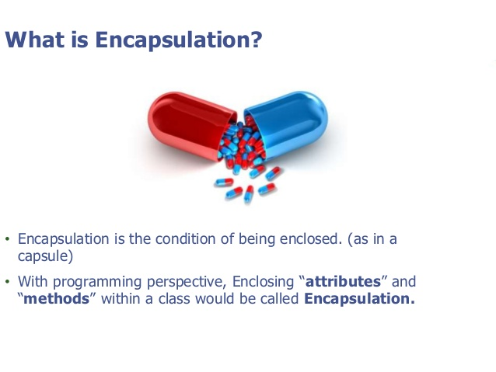
2. Encapsulation

Slide 22
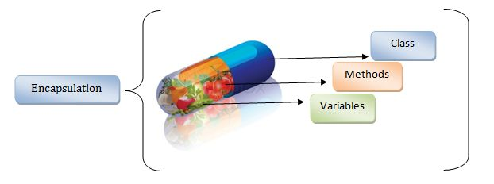
Encapsulation

Slide 23
Poly = many morph = form
3. Polymorphism
It is an ability of an object to take many forms.

Slide 24
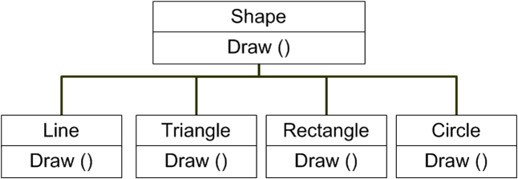
Polymorphism

Slide 25
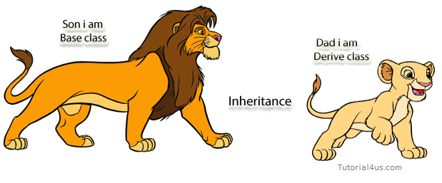
4. Inheritance
Inheritance is when an object acquires the property of another object.
Inherited class is called as parent class or super class or base class
Class that inherits a parent class is called as child class or sub class or derived class

Slide 26
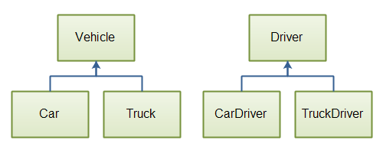
Example of Inheritance

Slide 27
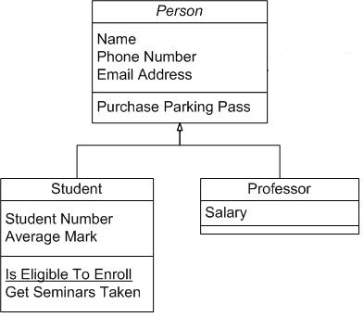

Slide 28

Thank you!

